Slide 1
FSM Online Internship
Chat-Bot for FSM
Nikita Sharma
Jaypee Institute of Information Technology, Noida
Under Mentorship of
Keivalya Pandya
IITD-AIA FOUNDATION FOR SMART MANUFACTURING

Slide 2
Project Background
In the support service, one of the most important aspect is quality and precise supports. Customers go through a lot of questions and problems from technological to data safety, and lack of support at any stage may prevent user/customer from using that particular technology making it a failure. Due to higher number of issues, large number of queries remain unanswered; sent through emails and call centers. This is where Machine Learning and Natural Language Processing can provide an alternative for Chat-support and user experience to support other service channels.
Challenges:
In order to achieve this we had various obstacles namely, data extraction and arranging it into squad dataset, lack of hardware resources like RAM,CUDA for processing large data, large training time.

Slide 3
Objective
Main Objective is to develop a Chatbot from scratch for a FSM website.
The Chatbot should be able to understand user queries or interactions within the context of the website.
Not only understanding queries but also generate relevant and accurate responses in real-time.
To provide an user interface to obtain information, support, or assistance related to the website’s content and services
Deploy the model for better reach

Slide 4
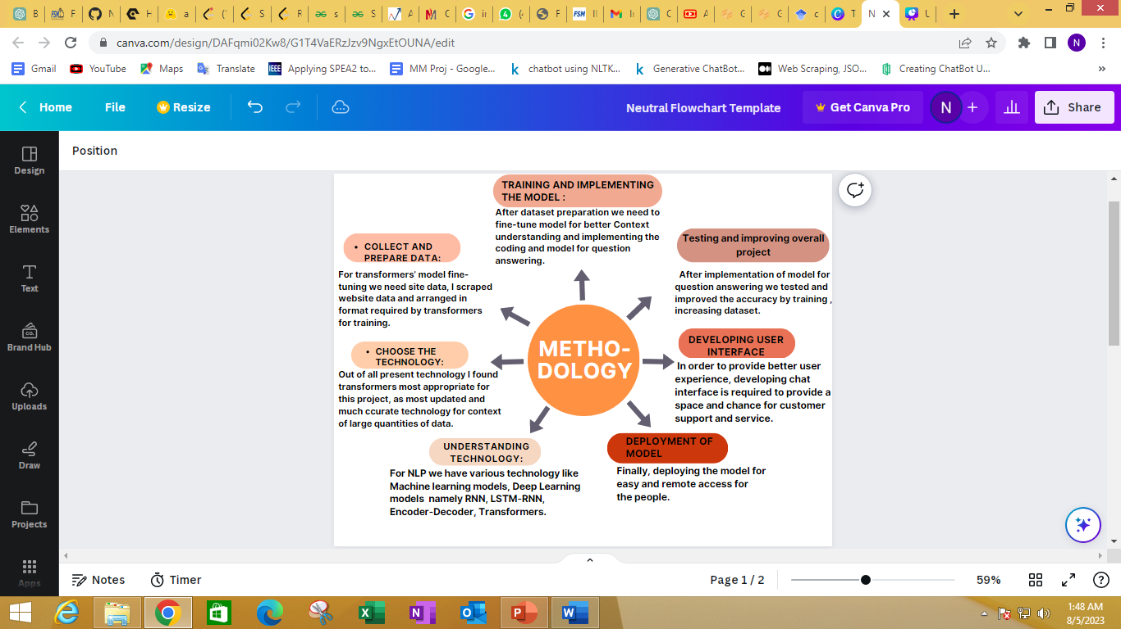
Methodology
.

Slide 5
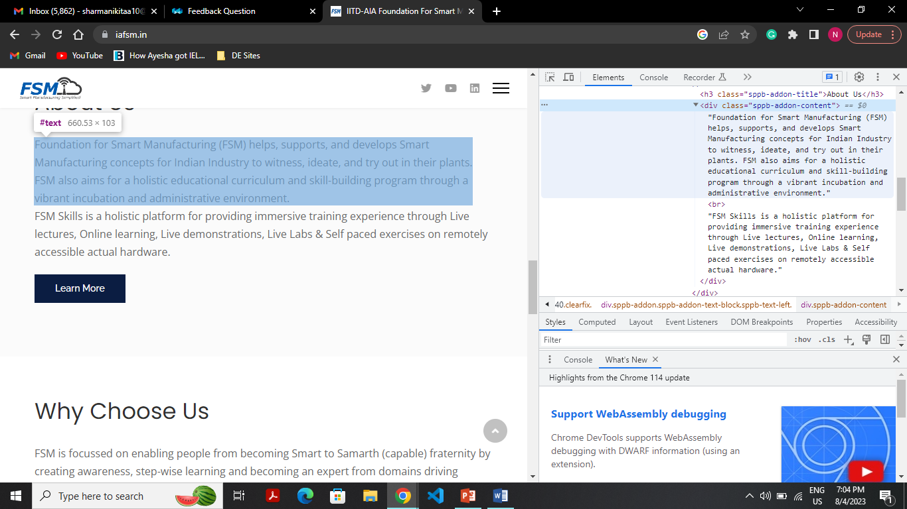
Implementation
Collect and prepare data:
Web scrapping was done using beautiful soup, and heading, paragraphs were extracted.
Some divisions As given in the fig (i) are extracted through searching div “sppb-addon-content”
Explained how scrapping of links was done for example button named “Learn more” .
|_Dashboard (1st link)
|_ all links on dashboard (eg. Links of Technologies, services, facilities)
|_ all links on redirected Page (eg. All the links on Technologies, Services page)
Scrapped data is in json format.
Fig (i) “About” Section of Dashboard Page (highlighted)

Slide 6
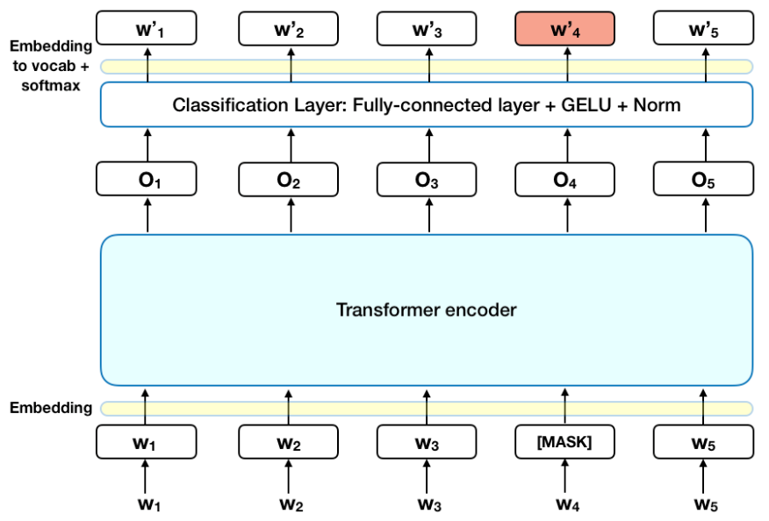
Implementation
Overview of Transformer :
Transformer is used when there is large context to understand. It consist of three things namely, encoder, decoder, Neural network. In this; question, context are provided to encoder. And there is neural network in between encoder and decoder. The weights of neural network provides the information which word in context need to be addressed and, has some importance, wrt context relation. These words (vector) are then passed to decoder which convert tokenized value to actual word and previous word is used to predict current word.

Slide 7
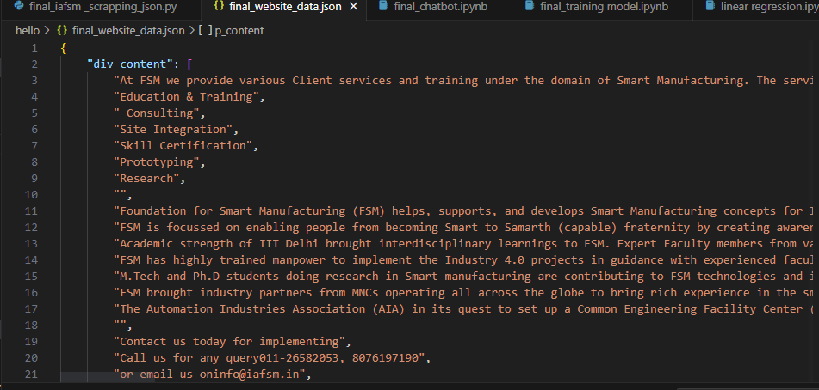
Implementation
Testing and improving overall project:
BERT model pre-trained on SQuAD is used.
To increase accuracy, the model is fine-tuned on website data.
Scrapped data was in json format Fig(iv), now processed the data to make it a context (removing symbols, spaces , lines).
Used the above context to generate question-answer in SQuAD format using Haystack Annotation Tool for fine-tuning. Fig (v),fig(vi)
5. Used 1.pipeline confidence score, 2.string search (target_word, topic on which question is
asked) to get exact answer.
Fig (iv)

Slide 8
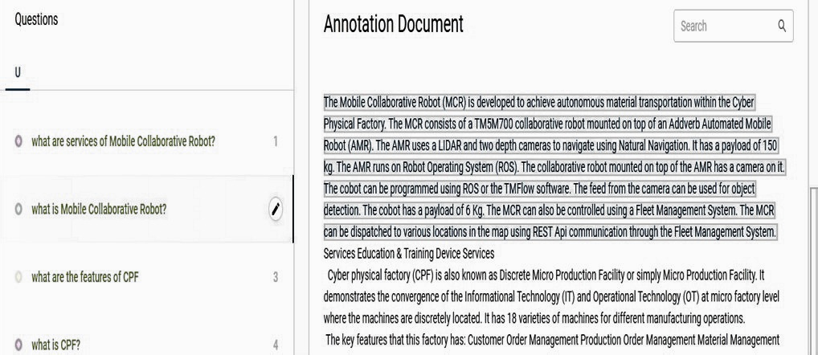
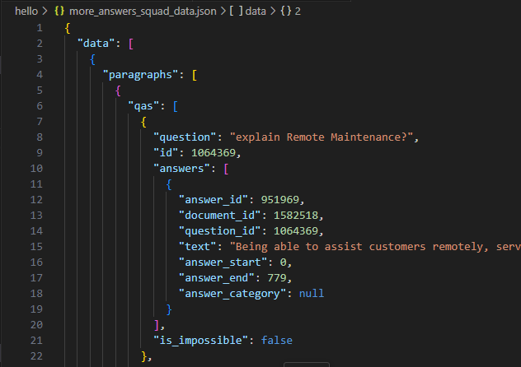
Fig (v)
Fig (vi)

Slide 9
Implementation
Developing User Interface:
For user interface I used Gradio as time was less , and I found it easy to implement where first, question answering interface was used. Then I got introduced to State parameter which used to keep all the asked question on screen like chats on WhatsApp if not refreshed. While, I was trying with state parameter I got to know about Chat Interface of Gradio. Now, this Chat Interface was used where I was getting errors of list and string. However, resolved them using print and type function.
Deployment of model (project):
Finally, deploying the model for easy and remote access for the people.I used Hugging-face spaces .
Here is the link for deployed model:
https://huggingface.co/spaces/Nickitaa/gradio-chatbot

Slide 10
Innovation in Implementation
1.I used fine-tuned DistilBERT model for predicting answers as fine-tuning was done
using CPU, so it has less parameter and fast in implementation and BERT for
Confidence score for choosing the correct answers from all the predicted answers of
DistilBERT.
2. After fine-tuning and training the model, bot was giving answers but there were
some extra stuff. So in order to solve this I used two things:
1. Confidence score 2. String search
I used a pipeline confidence score to search for answer that has correct context
with respect to question i.e. answer with high score.
For, string search I extracted out target_word from question; line having these
word are part of the exact final answer.

Slide 11
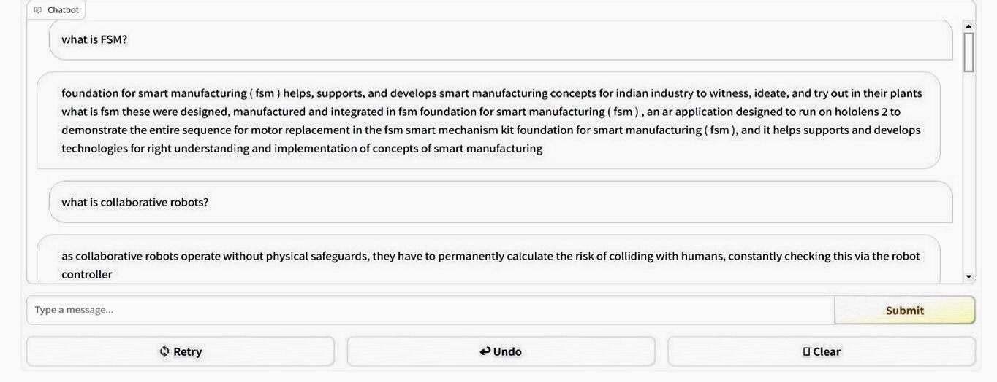
Outcome
After developing the graphic user interface of chat-bot system. Question is been typed in the prescribed area and answers related to that are generated. This, bot can answer questions related to site.
I tested my code against three different size of context
1. 512 tokens
2. 3 chunks each of 512 size
3. 28 chunks each of 512 size (complete site data)
Following is the output:
(output presented is using complete site data)

Slide 12
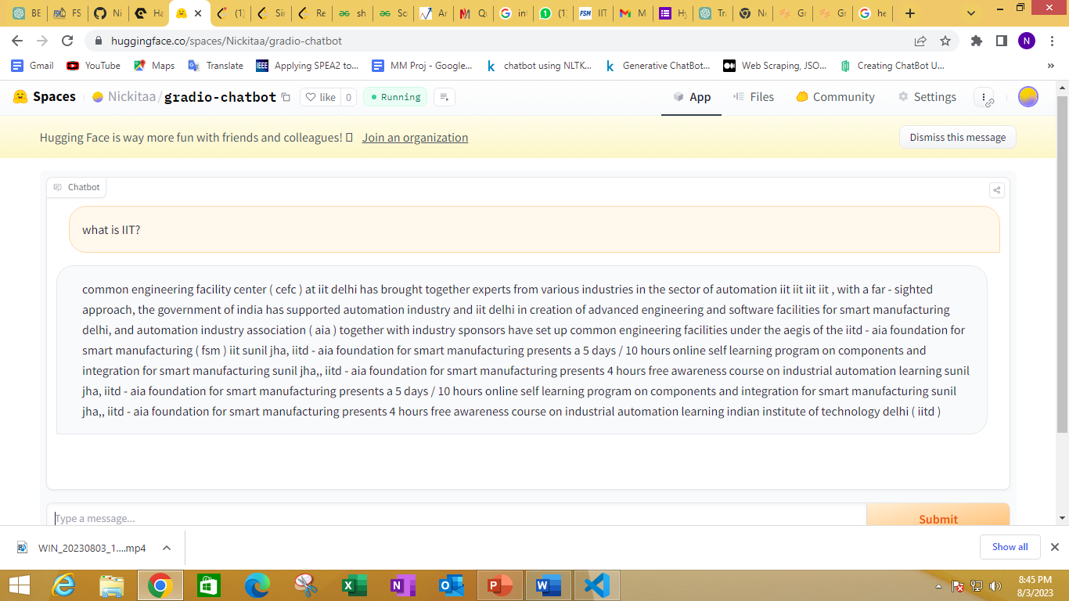
Results

Slide 13
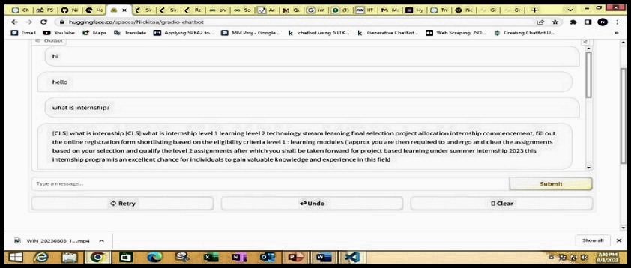
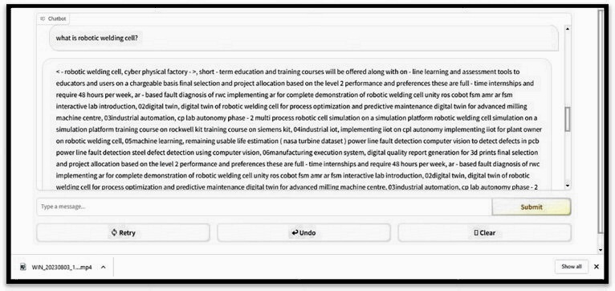
Results

Slide 14
Scalability
In the fourth industrial revolution, Smart and Samarth technologies are evolving and NLP will provide a hand for development.
In transformer model one of the important step for behavior of model towards prediction is fine tuning, model can be fine-tuned with customized data to suit specific requirements of industry and it can be domain specific and more relevant to industry.
Transformers model pre-trained in various international language are available in the industry. So, it can be deployed round the globe and international collaboration will be easy.
It can be relevant in assistance and support service, which the model is doing now i.e., aiding the user queries but it can provide assistance to developers in particular domain with respect t data provided.
If provided with resources like cloud, better processing units it can handle and can be accessible to wider audience with less execution time

Slide 15
Thank You
sharmanikitaa10@gmail.com

